Slide 1
Buyers Programme
BUSINESS SOLUTIONS PACKAGE COMBINING NEW ECONOMIC OPPORTUNITIES WITH AN UNFORGETTABLE STAY
October 28-30, 2013
Yerevan, Armenia
www.yerevanshow.com

Slide 2
Main parts
About Yerevan Show
2. Buyer’s Programme
Services
4. Top Reasons to Participate in Yerevan Show

Slide 3
About Yerevan Show
The 3rd International Jewelry Expo Yerevan Show will be held in the Karen Demirchyan Sports & Opera Complex, from October 28-30, 2013. Yerevan Show is organized by the Armenian Jewellers Association (AJA) in close cooperation with the Government of the Republic of Armenia, World Jewellery Confederation (CIBJO) and VICENZAORO – one of the world’s largest jewelry exhibitions.
By gathering manufacturers, wholesalers, buyers, specialists, potential partners and contractors, Yerevan Show has become a universal, multi-purpose platform for the jewelry industry.
Yerevan Show also serves as a venue for modern and unique jewelry to be displayed, and offers both buyers and exhibitors the opportunity to acquaint themselves with jewelry markets from different regions.

Slide 4
From an industry business aspect, Yerevan Show is:
– reflective of the jewelry industry’s latest technological advancements;
– a source of information on the latest trends worldwide;
– barometer for current prices;
– business forum forecasting the changes in the industry’s markets.

Slide 5
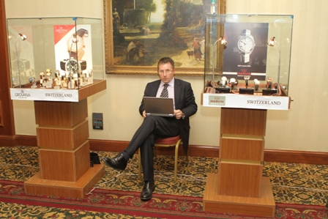
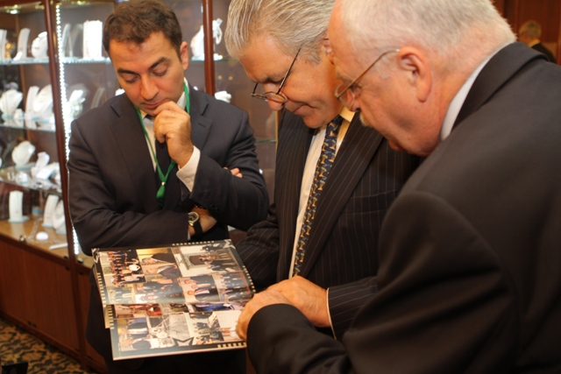
Yerevan Show is an easy-to-work marketplace, bringing the entire industry together for 3 focused days of buying, trend spotting, and business-building interaction.
A point of interest to buyers is the variety of exhibitors present at the Yerevan Show: Vendors range from high-end designers to major manufacturers and encompass different tastes, styles and price points.
By providing the possibility to view products simultaneously, Yerevan Show helps simplify and speed-up the decision making process when it comes to purchasing.

Slide 6
Buyers Programme
One of Yerevan Show’s priorities is to create favorable conditions on sales between buyers and exhibitors (manufacturers). Armenian Jewellers Association (AJA) acts not only as the organizer of Yerevan Show, but also as a service company to buyers, by providing post purchase commercial services, thereby reducing the exhibitors’ expenses.
The Yerevan Show Buyer’s Programme is a unique event as the exhibitors include not only jewelry companies but industry equipment suppliers as well. Buyers in the programme receive many privileges, customized service and additional advantages offered in preparation for the show and during the exhibition.

Slide 7
YOUR BUYERS PROGRAMME
BENEFIT PACKAGE INCLUDES
free buyers accreditation;
accommodations at Ani Hotel(****) from October 27-30, 2013 (4 days and 3 nights);
car service from/to airport and hotel;
shuttle bus from/to hotel and exhibition center;
planning and coordinating meetings between exhibitors and buyers and guests ;
complementary admission to AJA events and receptions;
participation in business program;
access to lounge section for private meetings & negotiations;
organized tours of the biblical land of Armenia;

Slide 8
COMMERCIAL SERVICES INCLUDED IN BUYERS PROGRAMME
Comprehensive support of the entire purchase procedure during the exhibition of jewelry products:
Preparation of customs clearance documents, shipping documents for goods exported from the Republic of Armenia for import into the Russian Federation & customs cargo clearance;
Transportation, freight forwarding support, jewelry insurance, air transport;
Organization of trade-settlement operations;

Slide 9
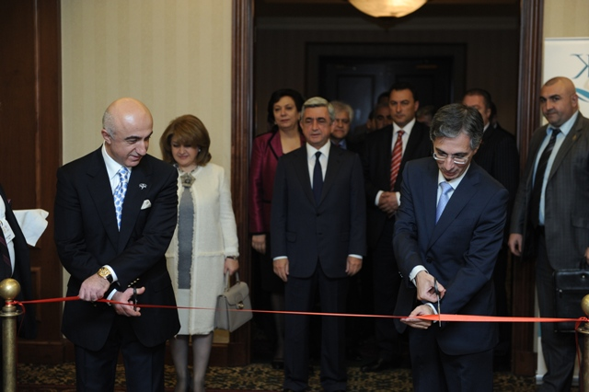
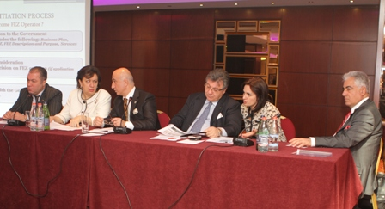
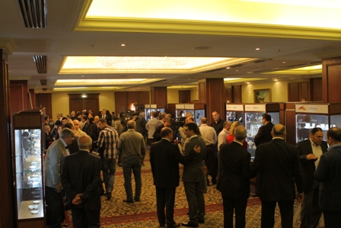
PROGRAMME
YEREVAN SHOW 2013
October 28-30, 2013 / YEREVAN, ARMENIA
October 28, 2013 10:00-17:00 | Exhibition hours
10:00 | Yerevan Show 2013 Opening Ceremony Under the Auspices of the President of Armenia, Serzh Sargsyan
14:00 – 17:00 | AJA Conference: The Current State of the Jewelry Industry: Issues and Perspectives
10:00 – 19:00 | B2B Operating Hours
19:30 | AJA Reception
October 29, 2013 10:00-17:00 | Exhibition hours
11:00-13:00 | Sightseeing Tour
17:00 | Visit to the Jewelry Free Economic Zone in Yerevan
19:30 10:00 – 19:00 | Gala Concert Event in Celebration of Armenia’s National Jeweler’s Day B2B Operating Hours
October 30, 2013 10:00-15:00 | Exhibition hours
11:00 | Press Conference with Media
15:00 | Exhibition Closing
10:00 – 15:00 | B2B Operating Hours
19:30 | Gala Dinner Hosted by Armenian Jewellers Association

Slide 10
PARTICIPANTS LIST OF YEREVAN SHOW 2013, CONFIRMED BY JULY 7, 2013
COUNTRY | COMPANY | WEBSITE
Armenia | Sarkis Sahakyan
Armenia | DCA
Armenia | Davtyan Designs
Armenia | Shiroyan Ara
Armenia | Arshak Manukyan –Samvel
Armenia | Grego LLC
Armenia | Yerevan Jewellery Plant-1 “Gnomon” OJSC
Armenia | Matrix
Armenia | Mondo di Oro
Armenia | Ametist
Belgium | SIGHTHOLDER
Great Britain | Backes&Strauss | www.backesandstrauss.com
Greece | OROFASMA Ltd. | www.orofasma.com
Greece | Danelian Diamond Club | www.diamondclub.gr
Egypt | Harry Kazandjian | www.vartanjewelry.com
Israel | SAHAR-ATID DIAMONDS LTD. | www.saharatid.com
India | Nihar
Iran | Tala jewelry house
Iran | Lazarian Jewelry
Italy | MIIORI | www.miiori.com
Italy | ART.OR.S.p.A.
Italy | Panelli Maria & C.
Canada | Canadian Gem | www.canadiangem.com
Canada | Malo Inc. 750 Cure-Labelle Chomedey, Laval, QC | www.malobands.com
Canada | GCI GEM CORP
Lebanon | DIKRAN | www.dikranjewelry.com
Lebanon | GEORGI SABOUNJIAN S.A.R.L. | www.georgisabounjian.com.lb

Slide 11
Lebanon | HAR-MEN Jewellers | www.harmenjewelry.com
Lebanon | GOLDEN DESERT
Lebanon | YEPREM JEWELLERY | www.yepremjewellery.com
Lebanon | TUFENKJIAN | www.tufenkjian.com
Lebanon | N.GEORGI SABOUNJIAN | www.georgisabounjian.com.lb
Lebanon | HAGOPIAN JEWELS | www.hagopianjewels.com
Lebanon | Zorab Creation | www.zorabcreation.com
UAE | Fancy Star Diamonds DMCC
UAE | Meru Gems
UAE | KP Sanghvi Middle East DMCC
UAE | Hiteshkumar Sanghvi
UAE | Damas | www.damasjewel.com
UAE | Three Star Jewellery LLC | www.threestarjewellery.com
Russian Federation | Estet | www.estet.ru
Russian Federation | GemEst | www.gemest.ru
Russian Federation | Gevorkian
Russian Federation | Adamant | www.adamant-gold.ru
Russian Federation | LLС Ekzol | www.ekzol.ru
Russian Federation | LLC Trio Profit | www.trioprofit.ru
Russian Federation | LLC Diamida
Russian Federation | LLC Hard Diamond
USA | Bergio | www.bergio.com
USA | R.H. & Company | www.RHandCo.com
USA | Infinity Line Jewelry MFG.INC | www.infinityline.net
USA | Simon G | www.simongjewelry.com
USA | World Jewelry Center | www.theworldjewelry.com
USA | TYCOON | www.tycooncut.com
USA | Kirk Kara | www.kirkkara.com
USA | HB Group | www.hbltd.us
USA | Bijou Tresor | www.bijoutresor.com
USA | SIERA | www.sierajewelry.com
Thailand | Sartoro | www.sartoro.net
Thailand | Jacob’s Jewelry Co., Ltd | www.jacobjewelry.net
Thailand | Artinian Co., Ltd. | www.artinian.net

Slide 12
Turkey | AREN STYLE Gold
Turkey | Cancan Gold
Turkey | Kizmazoglu Kuyum
Turkey | Alaattin Kameroglu | www.iko.org.tr
Turkey | BAG Jewelry | www.bagkuyum.com
Turkey | BAROCCO | www.baroccosilver.com
Turkey | MARANCI Jewellery
Turkey | ByART | www.byart.com.tr
Turkey | Matis | www.matis.com.tr
Turkey | Cesar Gold | www.cesargold.com
Turkey | Aren Style | www.arenstyle.com
Turkey | Vanli | www.vanli.com
Turkey | Safe | www.safe.com.tr
Turkey | Franco Fontana | www.francofontana.com.tr
Turkey | Bagjewelry | www.bagkuyum.com
Turkey | MARMARA KUYUMCULUK | www.marmarajewellery.com
Turkey | FANCY Jewellery CO.Ltd. | www.fancysilvertr.com
Turkey | Mesih | www.mesih.com
Turkey | Meral | www.meralgold.com
Turkey | Kuara | www.kuara.com.tr
France | Tellus
France | Moog | www.moog-design.com
France | Waskoll | www.waskoll.com
Switzerland | Montres Epos SA | www.epos.ch
Switzerland | ProTime | www.protime-distribution.ru
Switzerland | Jenanian & CO | www.jenanianandco.com
Switzerland | Eberhard
Switzerland | Alpina
Switzerland | Marvin
Switzerland | Grovana
Switzerland | Franck Muller | www.franckmuller.com

Slide 13
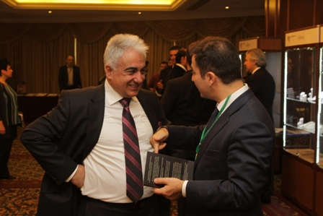
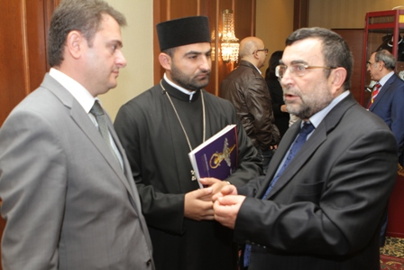
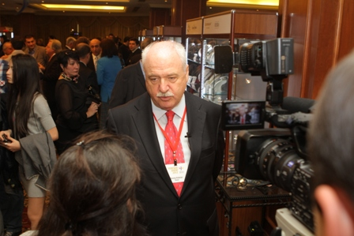
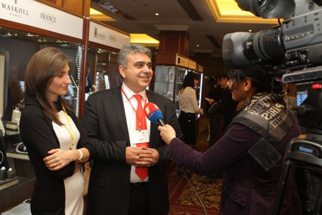
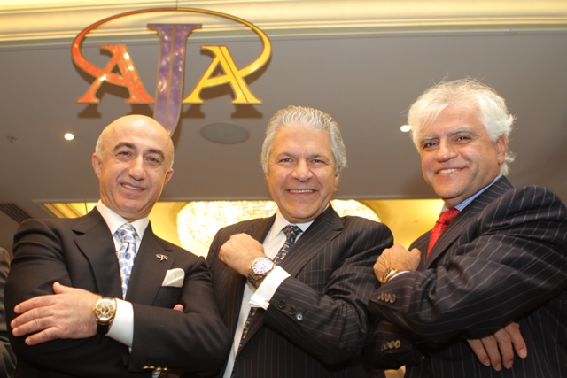
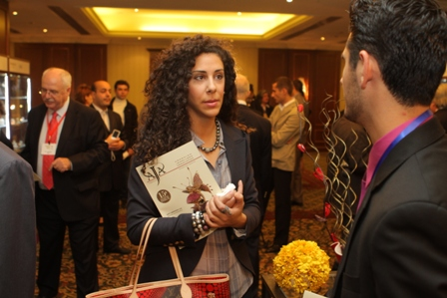

Slide 14
TOP REASONS TO ATTEND YEREVAN SHOW
Yerevan Show is an all-inclusive jewelry gathering in Armenia, offering excellent opportunities for business and networking.
While in Armenia, you can journey into the country, filled with its churches on top of mountains, the beauty of the land’s ancient ruins, its history, culture and religion. The biblical Ararat includes UNESCO world heritage sites, its beautiful natural landscape and its savory national cuisine .

Slide 15
Yerevan Show cultural programme will give you the opportunity to:
visit the historical center of the Armenian Apostolic religion – Echmiadzin Cathedral, the construction of which began in 303 immediately after Armenia became the first country in the world to adopt Christianity as a state religion;
visit Matenadaran -the world’s largest ancient manuscript repository. It was created on the basis of the nationalization of the collection of manuscripts of the Echmiadzin monastery in 1920. The chronological sequence of the exposition represents the national writing culture from the writing formation until the 19th century;
visit the ancient Garni fortress and hewn in the rock Geghard monastery complex. Meeting with its ancient temple of the Sun built in the 1st century will surprise you in Garni. Geghard will immerse you in the atmosphere of a medieval monastery;
take a tour to ARARAT Brandy Company (Plant), get acquainted with the Armenian cognac legend and the plant history which began in 1887. You will learn the technology behind the manufacturing of the drink, enjoy the flavor and taste different sorts of ARARAT cognac;
Аrmenian brandy (cognac) is a legend itself, which embodies the spirit of Armenia, its cultural and historical heritage. As Maxim Gorky wrote after his visit to Yerevan plant:”It is easier to climb Ararat mountain than to come out from Ararat cognac stocks.”
visit Noravank monastery decorated with highly artistic reliefs; one of the most valuable monuments of Armenian architecture of the 15th century. Some of the reliefs depict God’s Mother, sitting on a throne, and Prince Burtela with the set temple model in his hands;

Slide 16
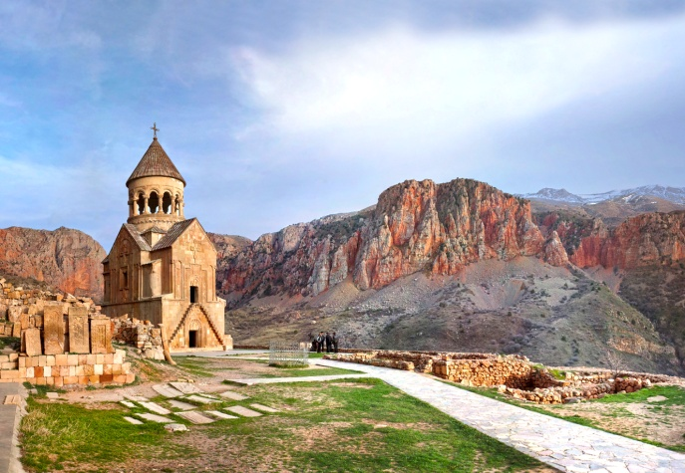
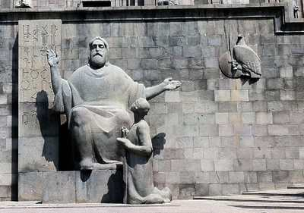
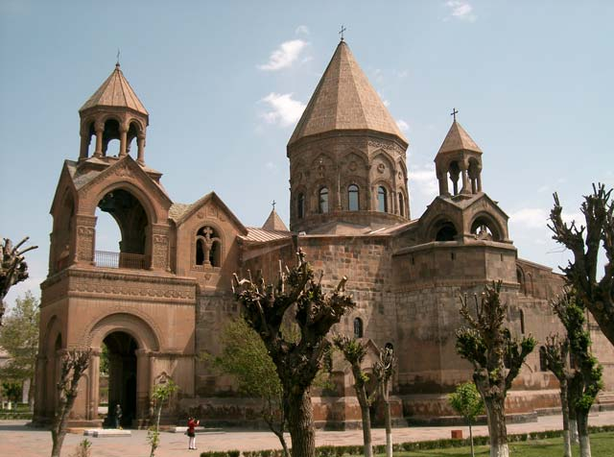
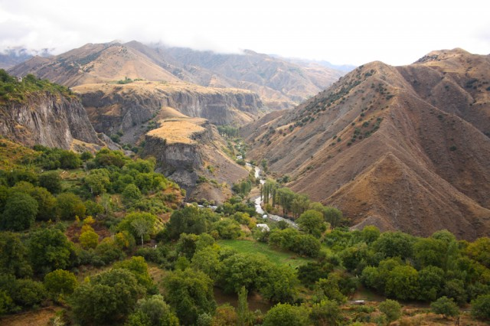
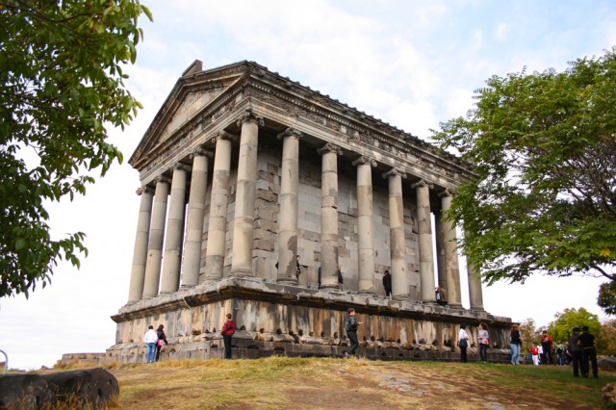
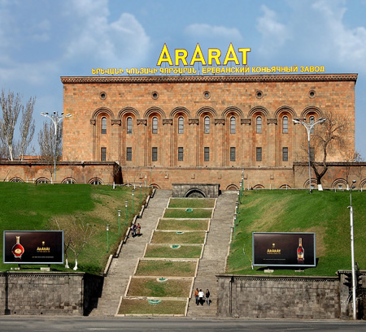
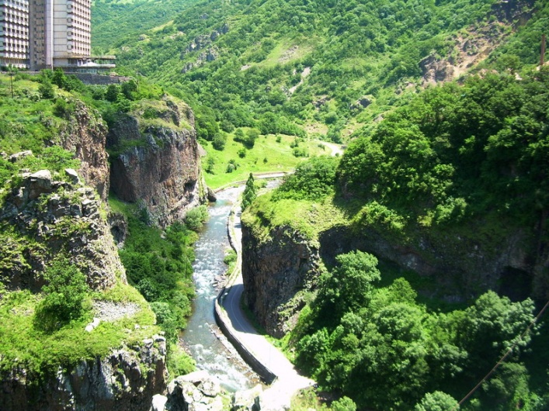
ARMENIA
The Biblical land of ancient monasteries

Slide 17
To register in the Buyer’s Programme, please fill in the Buyer’s Form and email it to AJA Central Office by September 30, 2013:
office@ajainternational.com or ys@ajainternational.com
For additional information, you may reach Nadezhda Mladentseva and Maria Ilyina directly at : Tel.:+ 7 (495) 988 77 55 Mob. tel.: +7 (915) 463 55 70

Slide 18
YEREVAN SHOW – YOUR INTERNATIONAL BUSINESS PARTNER
ys@ajainternational.com
+7(495) 988 77 55
+7(915) 463 55 70

